Slide 1


CONTENT SLIDE – Full image
Community Rapid Assessment – 1st Round Selected Visualizations on Trust and Health Care
Trust Health Care, Access to Services, and Barriers to Healthcare
UNICEF EO ILU

Slide 2
Community Rapid Assessment - 1st Round Selected Visualizations on Trust and Health Care
Deliverable Note
This deliverable includes 9 visualizations for three standard CRA questions. 1 Visualization is included per slide.
They include demographic breakdowns on sex and rural/urban setting.
CRA does not include a socio-economic indicator, as per the original request; therefore is not included.
This data points reflect the respondents and are preliminary. They have not been weighted yet for national estimations but show true distributions from national survey samples of more than 1,000 respondents per country.
Title of presentation
2
UNICEF PFP – for every child
2
UNICEF – for every child

Slide 3
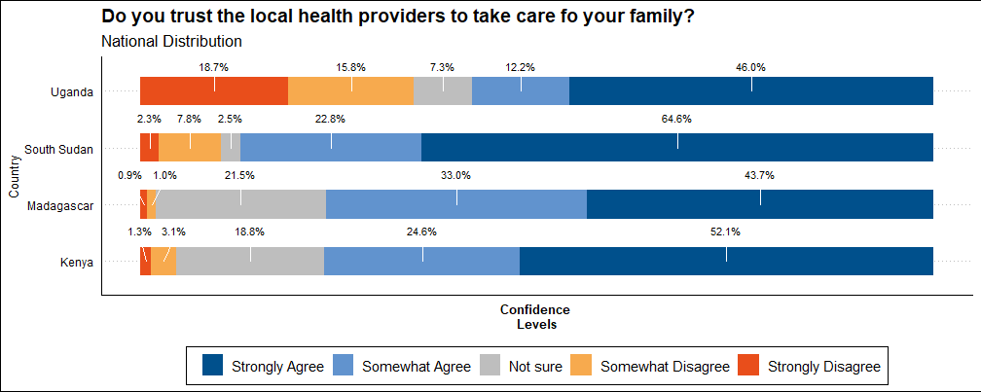

Slide 4
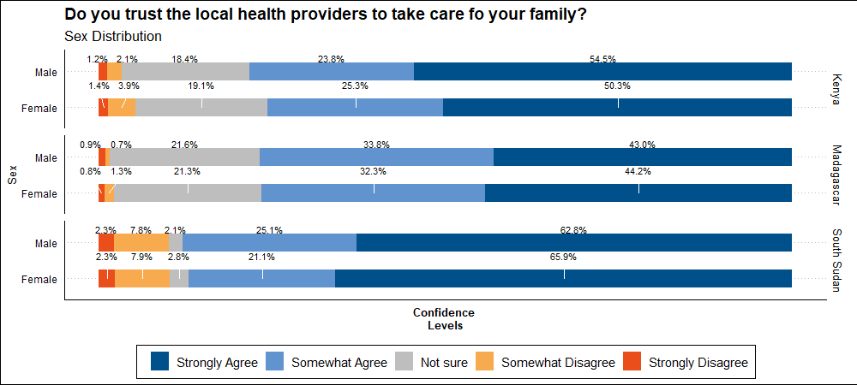

Slide 5
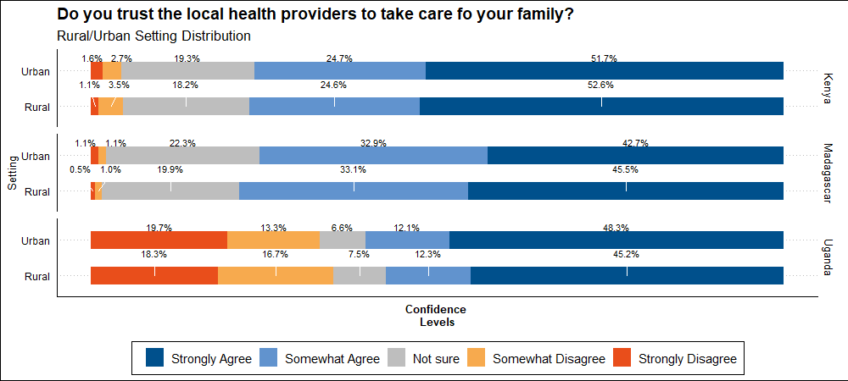

Slide 6
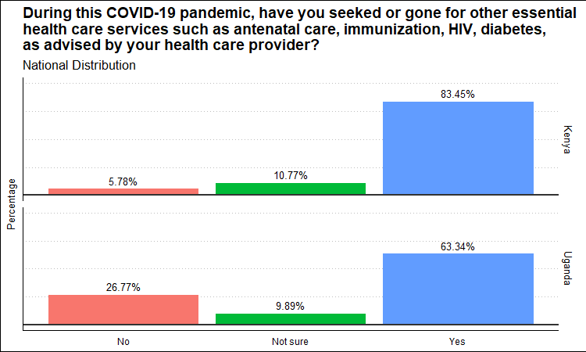

Slide 7
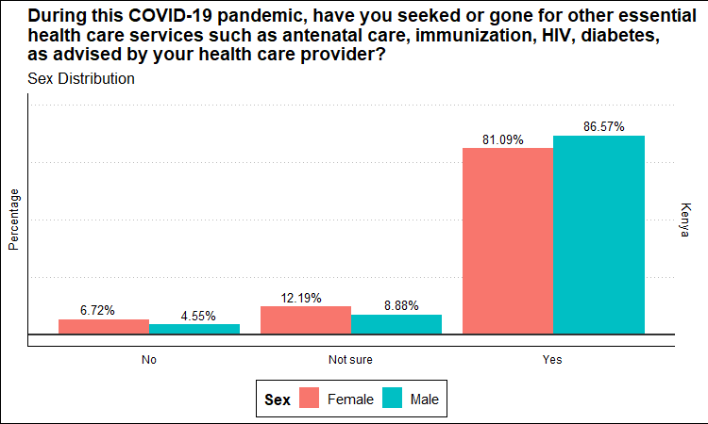

Slide 8
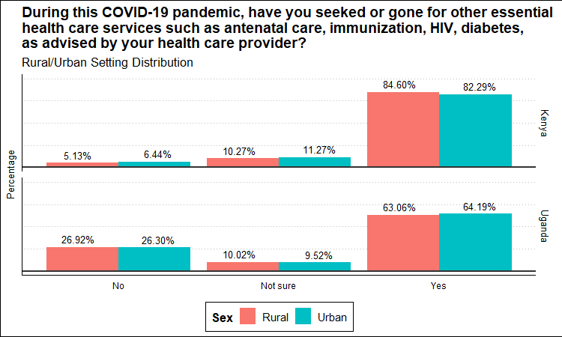

Slide 9
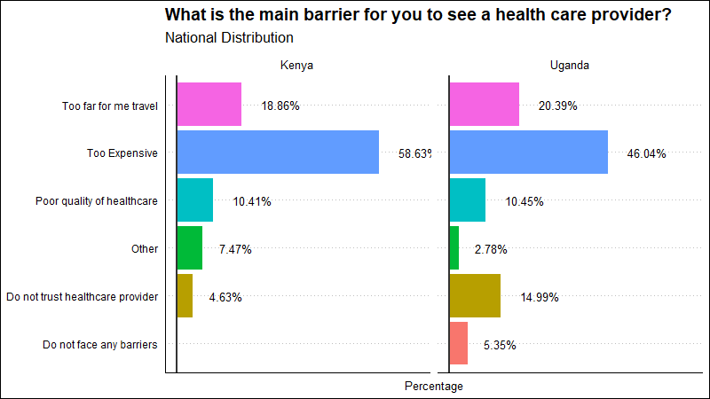

Slide 10
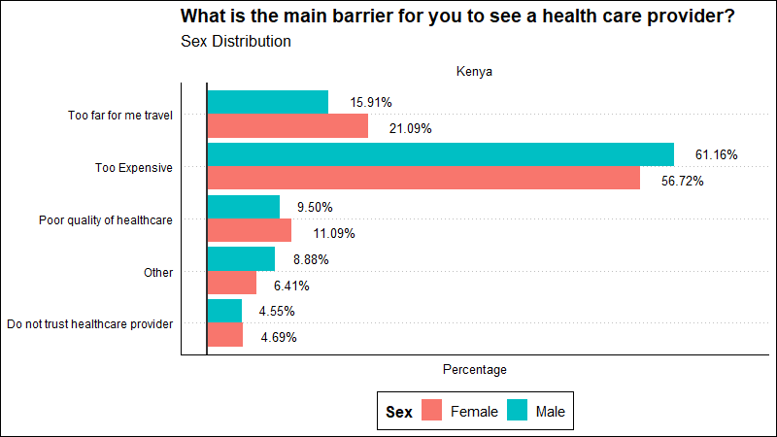

Slide 11
